Slide 1
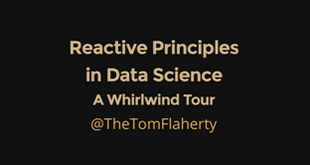
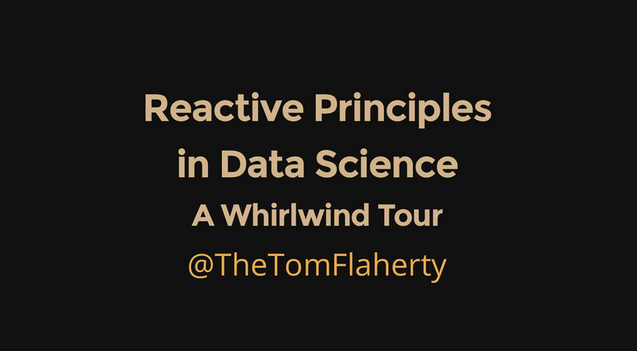
Reactive Principles
In Data Science
A Whirlwind Tour
@TheTomFlaherty

Slide 2
Abstract
The plethora of Data Science technologies and Big Data hype are making our heads hurt.
My mantra: Don't let brute force do your thinking for you.
Like everything in this distributed Information Age, Data Science is changing to meet new demands, with change motivating a new recognition of underlying principles.
So this lightning talk is then a whirlwind tour through these principles. We begin with Business Transformation, REST and NoSQL Databases. We then peak into the future with Grid Gain and Apache Spark and conclude with inﬂuence of the Reactive Manifesto.

Slide 3
Outline
So Many Technologies So Much Math
How Data is Transforming Business
A 100 fold increase in data volume under URIs Join the party with REST URI's
Visual Guide to NoSQL Systems Grid Gain
Apache Spark - Traditional Apache Spark - Revealed The Reactive Manifesto:
- How to be Responsive, Elastic, Resilient and Message Driven

Slide 4
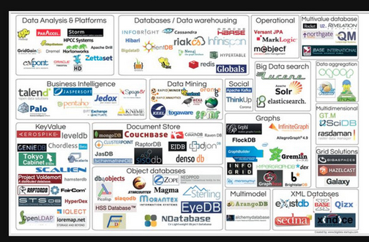
So Many Technologies

Slide 5
So Much Math

Slide 6
How Data will Transform Business
by Philip Evans TED talk on Nov. 2013
Since the 1970s, business strategy has been dominated by two major theories:
Bruce Henderson's idea of increasing returns to scale and experience
2. Michael Porter's value chain driven by transaction cost reductions
... a new force will rule business strategy in the future:
The massive amount of data shared by competing groups
The key driver is the 100 fold increase in data placed under URI's in the last 10 years Even better: This increases the number of patterns by 10,000 = 100x100 fold

Slide 7
A 100 fold increase in data volume under URIs
Is driving the growth of the ecosystem The Big Data Market Forecast

Slide 8
Join the party with REST URI's for Data
REST is the most profound step in becoming Reactively Message Driven The Internet itself is the best means of integration with caching as a bonus
REST is used by all major players: Google Amazon .. Just look at your browser Recommend JSON for the transaction "payload"
Rest URIs Are Easy To Read http://company.com/data/database/table/id?query
Below database="sales" table="cars" id is the last URI parameter
?query name value pairs (model="VW") provide nice extensions
Operation | Method | URI | Database Changes | Return
Create | POST | .../sales/cars | Row Created from JSON | ID new
Query | GET | .../sales/cars/1 | None | JSON row ID=1
Query | GET | .../sales/cars?model="VW" | None | JSON rows model="VW"
Query | GET | .../sales/cars | None | JSON for all rows
Update | PUT | .../sales/cars/1 | Row Updated from JSON | ID
Delete | DELETE | .../sales/cars/1 | Row Deleted | ID

Slide 10
Grid Gain / Apache Ignite
A Telepathic In Memory Computing Fabric

Slide 11
Grid Gain / Apache Ignite and Spark
Both share similar goals but "technologies are diﬀerent" Spark was specially designed for data processing
Grid Gain is a more generic distributed computation fabric that lets you easily farm out arbitrary tasks to nodes
Grid Gain works on Android since it has a JVM "Dalvik" A Grid Gain sensor array has untapped potential

Slide 12
Apache Spark
Traditional View
Core: GraphX: SQL:
Distributed task dispatching, scheduling, and basic I/O
A distributed graph topology for RDDs based on Pregel for Page Rank SchemaRDD a DSL feeding semi? structured data into RDDs
Ingests data in mini-batches for RDD transforms & streaming analytics Machine Learning Pipeline - Spark's original purpose
Streaming: MLlib :

Slide 13
Numerical
MLlib Machine Learning
Breeze GPU
Netlib - Fortran
IPython
PySpark
Streaming
SQL
RDD
Resilient Distributed Datasets
Play
Core Akka
Spark
Notebook
Cluster
Mesos Myriad YARN
GraphX
Cluster: Core Akka: RDD:
SQL:
GraphX: Streaming: MLlib : Numerical: IPython: Play: Notebook:
Mesos Myriad YARN
Distributed task dispatching, scheduling, and basic I/O
Resilient Distributed Datasets logically partitioned across machines SchemaRDD a DSL for feeding data into RDDs
A distributed graph topology for RDDs based on Pregel for Page Rank Ingests data in mini-batches for RDD transforms & streaming analytics Machine Learning Pipeline - with all the cool numerical libraries ScalaNLP(Breeze Epic Puck) GPU(cuBlas-NVidia) and NetLib-Fortran PySpark - Integration with the Data Scientist's favorite notebook Typesafe's web framework in Scala that interacts nicely with Akka
A Spark aware notebook in Play

Slide 14
The Reactive Manifesto
www.reactivemanifesto.org/
Responsive
Elastic
Resilient
Message Driven
Responsive: | In Memory | Always respond meaningfully in a timely manner
Elastic: | Cluster | Stay responsive under varying workload
Resilient: | RDD | Stay responsive in the face of failure
Message Driven: | Streaming | Wrap and stream messages asynchronously

Slide 15
Responsive
Always respond meaningfully in a timely manner
"In Memory" improves performance by 1-2 orders of magnitude Formulate meaningful response metrics for Data Science Leverage statistics to shrink sample populations
Weigh beneﬁts between real time and near time Keep your common sense
Don't let brute force do your thinking for you

Slide 16
Elastic
Stay responsive under varying workload
Elasticity is the key value proposition for cloud hosting Leveage Spark's integration with Akka Mesos Myraid and YARN
Always have spare resources available to spin up for peak demand Spend the extra money to replicate data

Slide 17
Resilient
Stay responsive in the face of failure
Clustered servers and network links fail all the time Spark Core monitors and responds to cluster failure RDDs "Resilient" Distributed Datasets says it all RDDs shard the data over a cluster
RDDs reconstitute shards lost due to node / link failures
RDDs in Spark can rerun their transforms to recreate lost data

Slide 19
References
Big Data Driving Business REST API Tutorial
CAP Theorem Grid Gain Apache Spark
The Reactive Manifesto PDF at Speaker Deck
http://bit.ly/194auY9
http://www.restapitutorial.com/resources.html
http://en.wikipedia.org/wiki/CAP_theorem http://www.gridgain.com/
https://spark.apache.org/
www.reactivemanifesto.org/ https://speakerdeck.com/axiom6/RxDataScience

Slide 20
The End

