Slide 1
Using Event Data to Enhance Analytic Models
HackSki
Data Scientist
February 28, 2015

Slide 2
What is Event Data?
Records of an occurrence
Has a timestamp
Usually very granular
Accidents
Construction
Rockslide
Avalanche
Road Closures
Upgrade Phone
Dropped Call
Make a Payment
Add a Line
Check Contract End Date
Bird-Kicked Finch
Bit Fatty
Lost Almond
Found Almond
Vet Visit

Slide 3
Bird Event Log

Slide 4
Sequence of Events by Bird

Slide 5
Analytic Data Set
rpart(formula=Outcome~bird_kicked_finch+found_almond+stole_almond+bit_fatty+got_bit+got_kicked+bird_s+bird_kicked_finch_got_bit+got_kicked_bit_fatty,
data=bird_day.df,
method=”class”)

Slide 6
Variables You Might Want to Include
Event Duration
Duration Between Events
Duration of Drive by Segments
Time of Day by Segments
Number of Events
Number of Events in Subsequence
Temperature
Is it Snowing? (Y/N)
Number of Accidents

Slide 7
Minds think with ideas, not information. No amount of data, bandwidth, or processing power can substitute for inspired thought.
— Clifford Stoll

Slide 8
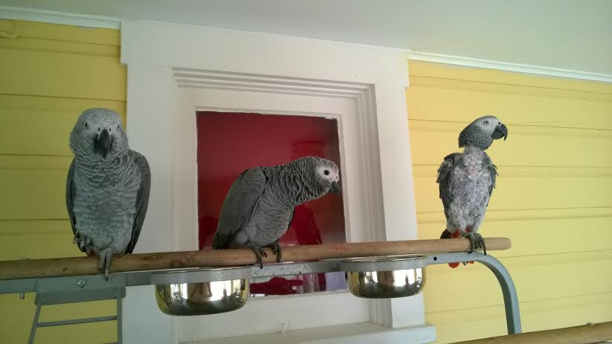
Tailess Fatty Finch

Slide 9
Questions?
Jennifer.Evans@Clickfox.com

