Slide 1


High-throughput sequencing and big data: implications for personalized medicine?
Dominick J. Lemas, PhD
Postdoctoral Fellow in Pediatrics - Neonatology
Mentor: Jacob E. (Jed) Friedman, PhD

Slide 2
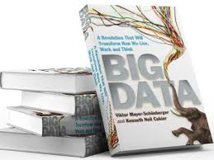
What is Big Data?
Top Tech phrase of 2013¹
Messy, Noisy, Imprecise
Datafication
Repurposed
N= All
Privacy?
¹http://www.languagemonitor.com/

Slide 3
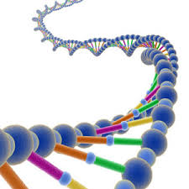
What is the human genome?
Human body contains trillions of cells.
Each cell contains a nucleus.
Each nucleus contains 2 complete genomes.
. . . . . . .
  OR if the genome was a book!
  There are 23 chapters → chromosomes
  Each chapter contains several hundred stories→ genes
  Each story is composed of paragraphs → exons
  Interrupted by advertisements → introns
  Each paragraph is made up of words → codons
  Each word is written in letters → bases . . . A,C,T,G
Genome. Matt Ridley. 1999

Slide 4
Goals of Human Genome Project
Generate working draft of 90% of the human genome (2001).
Obtain complete, high-quality genomic sequence (2003).
Make all data publically available.
Develop novel sequencing technologies.
Map Sequence Variation.
Interpret functions of genome.
Develop comparative genomic strategies.
Ethical, legal and social implications (ELSI).
Bioinformatics and Computational Biology
Training

Slide 5
Benefits of Sequencing Human Genome
Molecular Medicine
Energy and Environmental Applications
Bioarcheology, anthropology, evolution, human migration
DNA forensics
Agriculture, livestock breeding, and bioprocessing

Slide 6
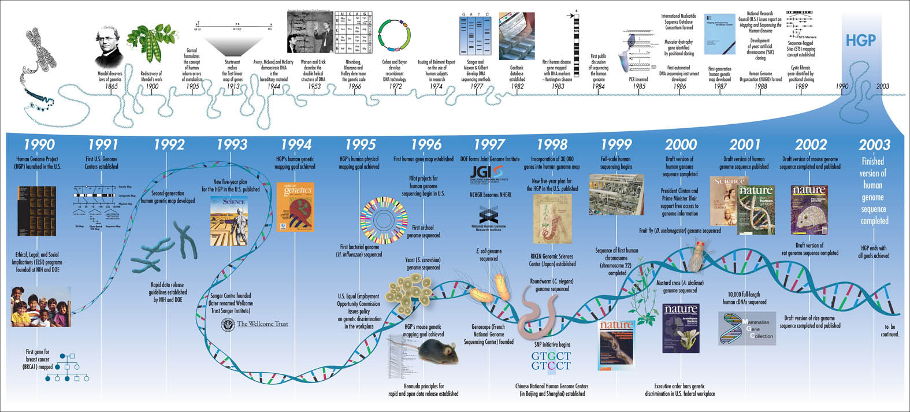
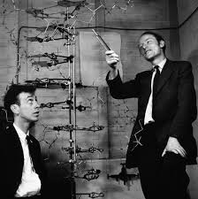
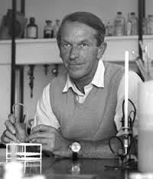
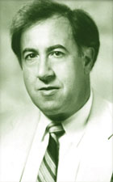
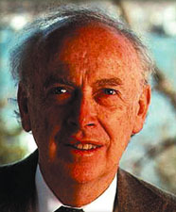
Sequencing Milestones: the early days
1953
1977
1985
1988
Watson & Crick
Fredrick Sanger
Charles DeLisi
James D. Watson
Collins. 2001.Nature 422, 835-847

Slide 7
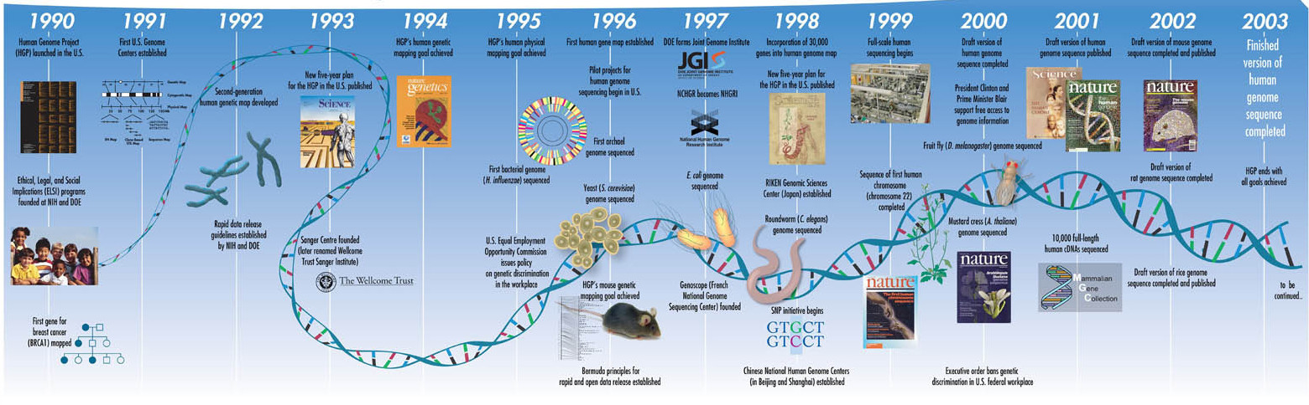

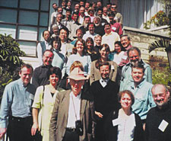
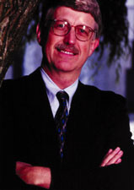
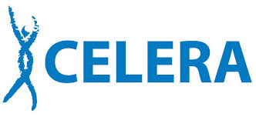
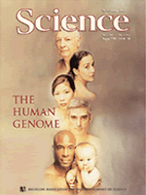
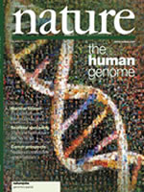


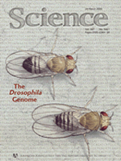
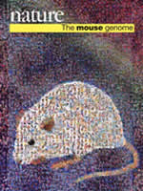
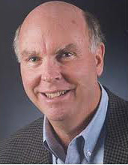
Sequencing Milestones: HGP
Bermuda Principle
Francis Collins
H. influenzae Sequenced
C. elegans Sequenced
D. Melanogaster
Sequenced
Craig Venter
Collins. 2001.Nature 422, 835-847

Slide 8
The International Human Genome Sequencing Consortium
G5- Completed Bulk of Sequencing
Whitehead Institute/MIT Center for Genome Research, Cambridge, Mass., U.S.
The Wellcome Trust Sanger Institute, Hinxton, Cambridgeshire, U.K.
Washington University School of Medicine Genome Sequencing Center, St. Louis, Mo., U.S.
U. S. Department of Energy Joint Genome Institute, Walnut Creek, Calif., U.S.
Baylor College of Medicine Human Genome Sequencing Center, Houston, Tex., U.S.
RIKEN Genomic Sciences Center, Yokohama, Japan
Genoscope and CNRS UMR-8030, Evry, France
GTC Sequencing Center, Waltham, Mass., U.S.
Department of Genome Analysis, Jena, Germany
Beijing Genomics Institute/Human Genome Center, Beijing, China
Multimegabase Sequencing Center, Seattle, Wash., U.S.
Stanford Genome Technology Center, Stanford, Calif., U.S.
Stanford Human Genome Center, Stanford, Calif., U.S.
University of Washington Genome Center, Seattle, Wash., U.S.
Department of Molecular Biology, Tokyo, Japan
University of Texas Southwestern Medical Center at Dallas, Dallas, Texas, U.S.
University of Oklahoma's Advanced Center for Genome Technology, Norman, Okla., U.S.
Max Planck Institute for Molecular Genetics, Berlin, Germany
Cold Spring Harbor Laboratory, Lita Annenberg Hazen Genome Center, Cold Spring Harbor, N.Y., U.S.
GBF - German Research Centre for Biotechnology, Braunschweig, Germany

Slide 9
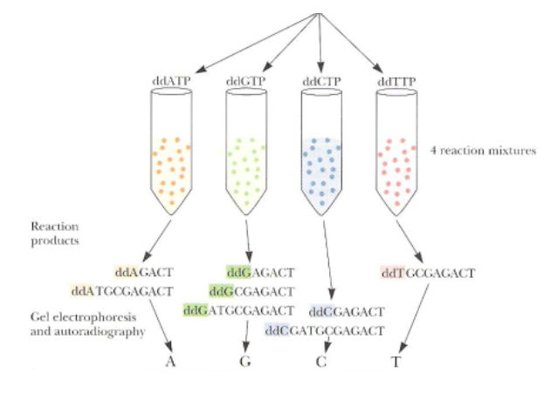
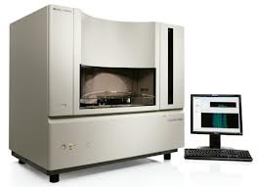
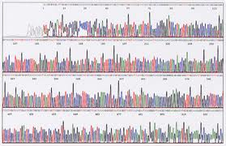
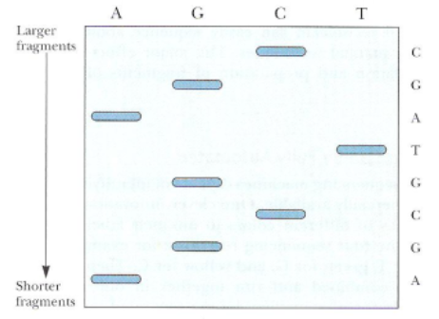
Sanger Sequencing
DNA Template
The ABI Prism 3700 /3730
1975-1991
1992-2000’s
A
G
C
T
$300,000/machine
Sequence 50-100K bp/hr

Slide 10
Whole-Genome Sequencing
Break genome into small pieces called “reads”
Sequence reads
Assemble Reads

Slide 11
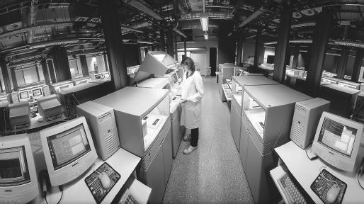
Computational Challenges
Coverage?
Imputation?
Alignment?
Formatting?
Analysis?

Slide 12
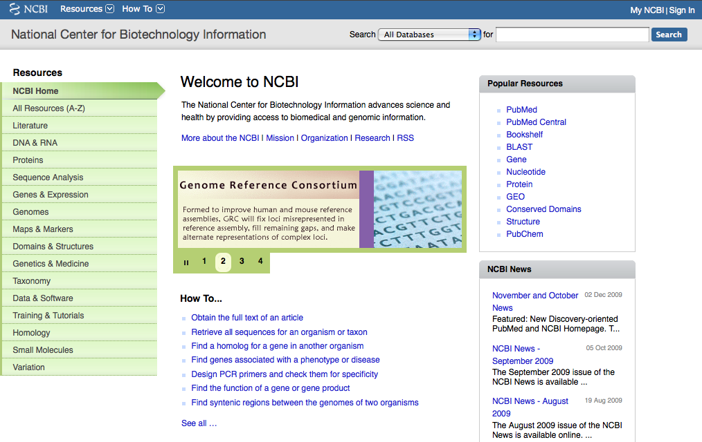
Where does the data live?

Slide 13
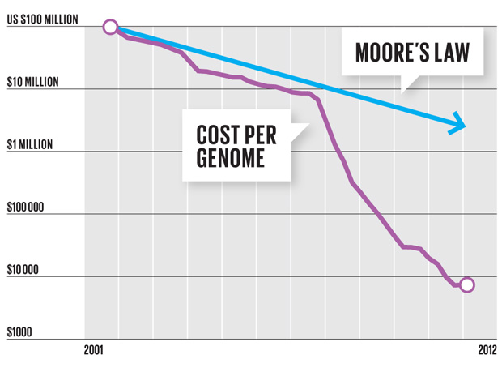
Sequencing has gotten Cheaper and Faster
Cost of one human genome
HGP: $ 3 billion
2004: $30,000,000
2008: $100,000
2010: $10,000
2011: $4,000
2012-13: $1,000
???: $300

Slide 14
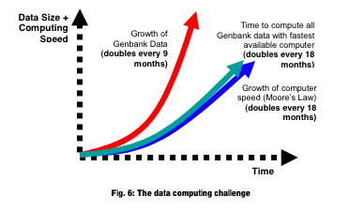
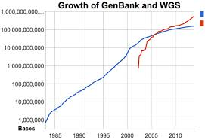
BIG DATA & Sequence
Whole-Genome Shotgun (WGS)
GenBank
http://plone.hpcf.upr.edu/Members/humberto/class/2006/bioinformatics/bioinformatics
ftp://ftp.ncbi.nih.gov/genbank/gbrel.txt

Slide 15
So What Did We Learn?
<3% of genome encodes ~20,000 genes.
More than half of genome is repetitive.
Identification of ~2,850 gene impact rare diseases.
~1,100 markers affecting common disease & ~150 targets for cancer.
“Big Science” can win.
Cost of sequencing per base has been reduced by magnitude of ~100k.
Lander. 2011. Nature 470 , 187-197

Slide 16
Emerging Applications of Sequence data
Gene Expression?
Genetic Variation?
Human Genome Sequence
Epigenetic Variation?
Microbial Variation?
Metabolites?

Slide 17
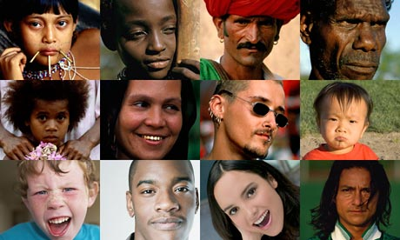
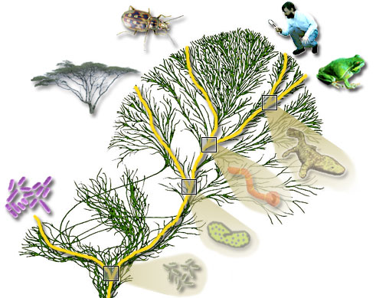
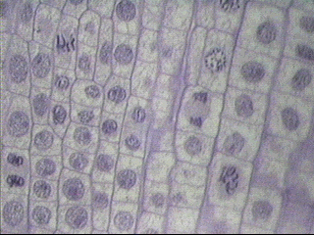
Mapping Genetic Variation
~7 billion people
~8.7 million species
~37 trillion cells/human

Slide 18
Obesity is Complex
Obesity
Environment
Genes

Slide 19
Gene-Environment Interactions
Genotype
A/A
A/B
B/B
Disease Risk
Environment

Slide 20
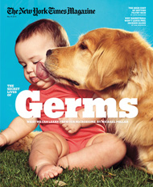
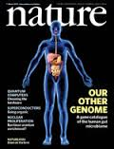

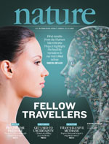
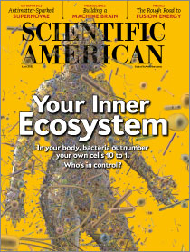
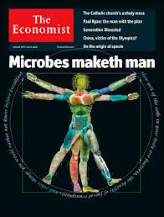
Variation in the Human Microbiome
Microbe: tiny living organism, such as bacterium, fungus, protozoan, or virus.
Microbiome: collectively all the microbes in the human body; a community of microbes.

Slide 21
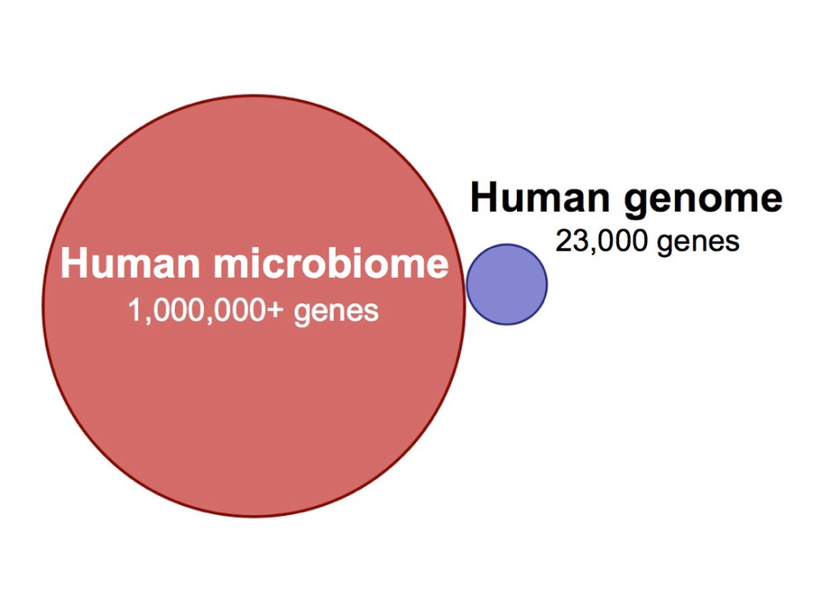


Variation in Human Microbiome?
Relative to humans:
9 in 10 cells are microbial!
~1000 different species.
~150x more genes.
~3lbs of microbes in the human gut.
~60% of stool by dry mass is microbial.
Mass of Moon
7.3 x 10²² kg
Primary functions of the microbiome:
Stimulate the development of our immune system.
Resist colonization by pathogens.
Extract energy from food.
Mass of Earth
5.9 x 10²⁴ kg

Slide 22
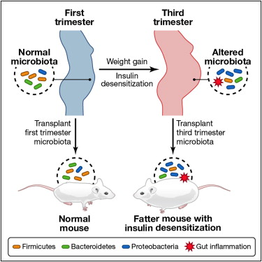
Does the microbiome impact maternal metabolism during pregnancy ?
Koren et al 2012
We hypothesize the maternal microbiome in mothers will directly affect the development of the infants microbiome and adiposity during the first year of life.

Slide 23
Overview of Specific Aims
Pregnancy
Maternal Phenotype
NW
OW/Ob
T2D
GDM
SA3
Maternal Microbiome
Stool
Human Milk (HM)
Infant Microbiome
Stool
Infant Adiposity
Time
4 months
SA1
SA2

Slide 24
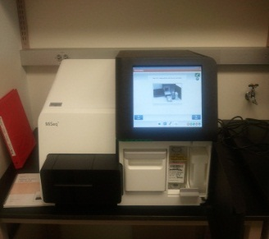
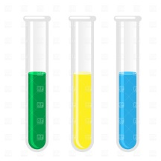
How Do You Measure the Microbiome?
Target Highly Conserved Bacterial Gene
Illumina MiSeq Personal Sequencer
Who is present?
DNA samples
What are they doing?
Target All Bacterial Genomes

Slide 25



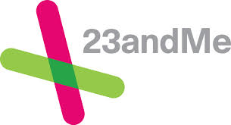



Moving toward a Personalized Medicine?
But has sequencing the human genome improved health?

Slide 26
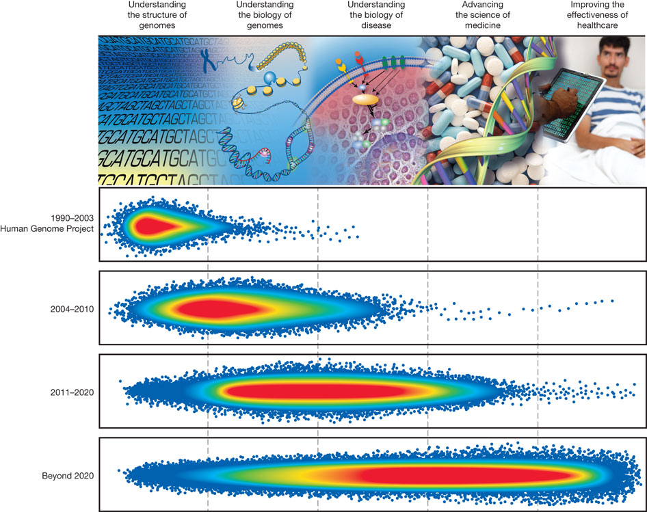
Five Domains of Genomic Research
Green. 2011. Nature 470, 204-213

Slide 27
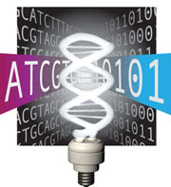
Bioinformatics and Computational Biology to the Rescue?
Data Analysis- existing tools are becoming inadequate to analyze data.
Data Integration- Need to harmonize disparate data types.
Visualization- Need to accommodate multi-dimensional data.
Computational Tools and Infrastructure- storage, capacity, privacy.
Training- Need biologist, computer science, informatics, data science . . . . . .
Green. 2011. Nature 470, 204-213

Slide 28
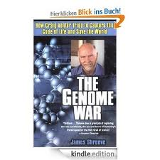



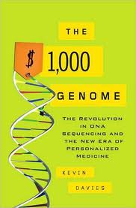
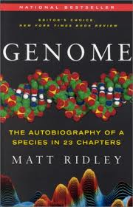

Recommended Reading

Slide 29

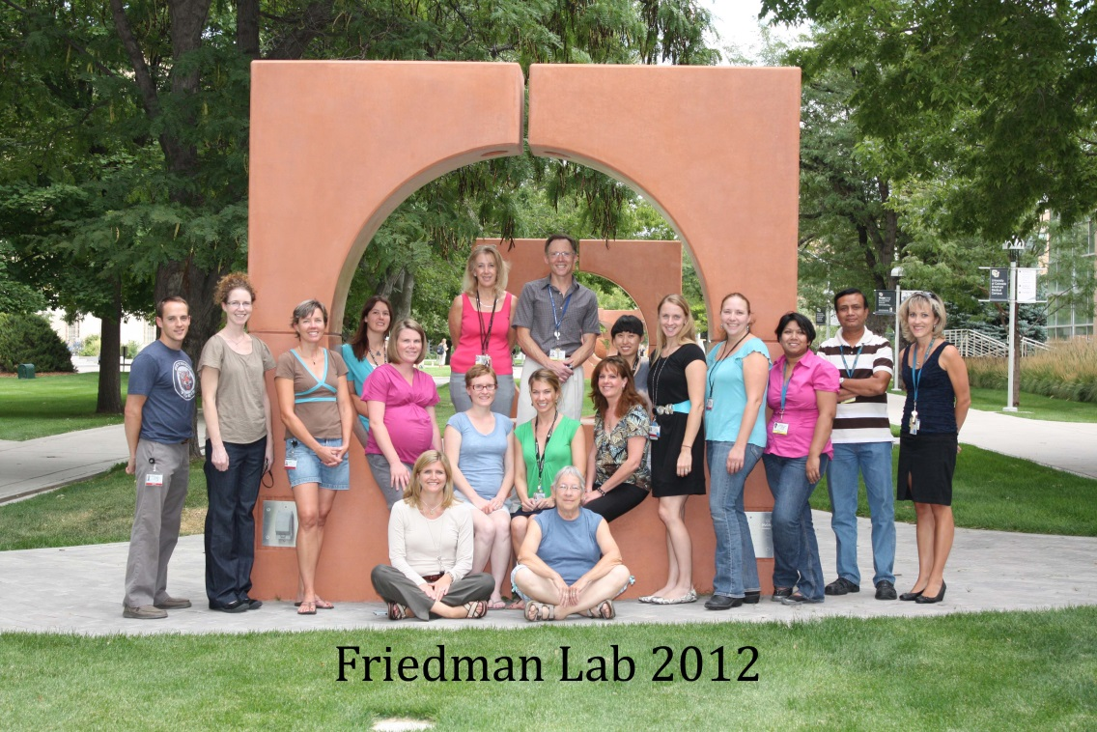
Special Thanks to:
My mentors
Jacob E. Friedman, PhD
Daniel N. Frank, PhD
Stephanie A. Santorico, PhD
Linda A. Barbour, MD, MSPH
Dana Dabelea, MD, PhD
Funding Support:
ADA/Glaxo-SmithKline
T32-HD07186
Questions?

