Slide 1
Constraints of Current HPC System Architectures
by:
Michael Walker
Data Science Association
http://www.datascienceassn.org

Slide 2
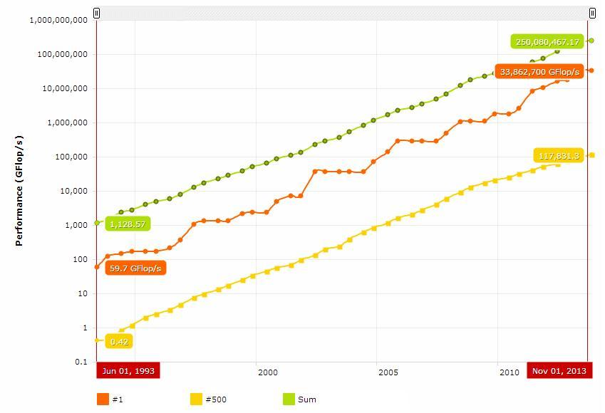

Slide 3
Bottlenecks and Constraints
Overhead and resource consumption due to I/O
Impact of shuffle
Lack of scalability in compute terms
Lack of scalability in cluster growth

Slide 4
Negative Performance Issues
Application response time (latency)
System efficiency
Scalability
Complexity

Slide 5
System Architecture Solution
What do end users care about?
Performance - speed - accuracy - full end-to-end job time
Ease of use
System efficiency
ROI / TCO

Slide 6
System Architecture Solution
Innovative heterogeneous systems architecture
Goal: eliminate bottlenecks of clustered systems that impact performance (especially application response time), system efficiency, scalability and complexity

Slide 7
System Architecture Solution
New scalable, distributed system with specific architecture and design
Consisting of software and hardware
For distributed applications

Slide 8
New System Architecture Benefits
Speed and efficiency of data processing
Performance of existing applications
Performance of critical in-memory database applications or other applications
Increased scalability

