Slide 1
Intelligent Outlier Detection Algorithm
Andrew Weekley
National Renewable Energy Lab
Andrew.weekley@nrel.gov

Slide 2
Acknowledgments
Co-investigators
Kent Goodrich (CU Boulder Dep. of Math, NCAR)
Larry Cornman (NCAR)
Work originally funded by the National Center for Atmospheric Research
Work performed while employed by NCAR

Slide 3
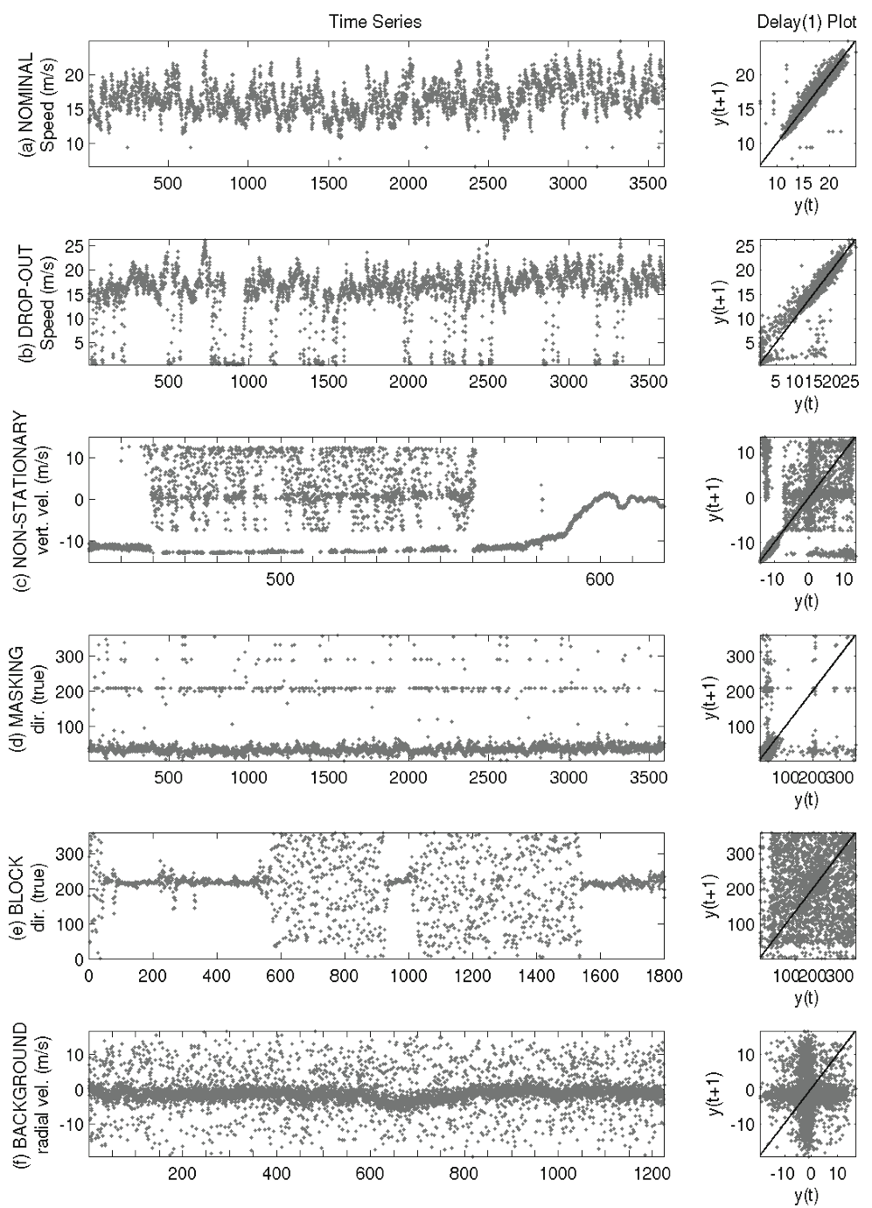
Cases studied

Slide 4
Final Confidence

Slide 5
Finding Suspect Data
Humans can identify suspect data in a time series with little or no information
Finding suspect data with a computer may involve calculating a statistic
The statistic may be used to identify the suspect data
But the suspect data corrupts the statistic
And depending on the situation the statistic may not identify the suspect data

Slide 6
Scatter Plot of Y(t₂) vs. Y(t₁)

Slide 7
Optimal clusters
optimal clusters in time domain and delay space
build a “feature” in the time domain from optimal clusters in the time domain
drop-out and non-stationary cases have two optimal clusters in delay space, but distinct representations in the time domain.
nominal, block and uniform cases have single clusters in delay space but distinct representations in the time domain

Slide 8
Final Confidence

Slide 9
Simulated example
Identified a set of feature vectors which could be used in a machine learning algorithm such as SVM
Build a training data set using simulated data

Slide 10
References
Ma, J., and S. Perkins, 2003: Time-series novelty detection using one-class support vector machines. Proceedings of the International Joint Conference on Neural Networks, 2003., Vol. 3 of, IEEE, 1741–1745
Weekley, R. A., R. K. Goodrich, and L. B. Cornman, 2003: Fuzzy Image Processing Applied to Time Series Analysis. 3rd Conference on Artificial Intelligence Applications to the Environmental Science, Vol. 54 of, Citeseer, 258
Weekley, R. A., R. K. Goodrich, and L. B. Cornman, 2004a: Feature Classification for time series data. US Patent 6,735,550.
Weekley, R. A., R. K. Goodrich, and L. B. Cornman, 2010: An Algorithm for Classification and Outlier Detection of Time-Series Data. Journal of Atmospheric and Oceanic Technology, 27, 94–107, doi:10.1175/2009JTECHA1299.1.

